Slide 1



Spring Security Password Encryption
m

Slide 2
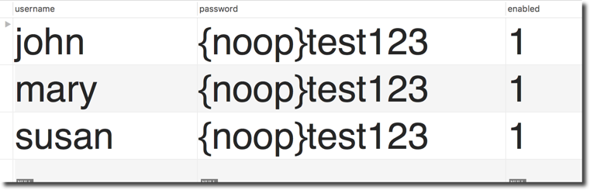
Password Storage
So far, our user passwords are stored in plaintext … yikes!
•
Ok for getting started … but not for production / real-time project :-(
www.luv2code.com

Slide 3
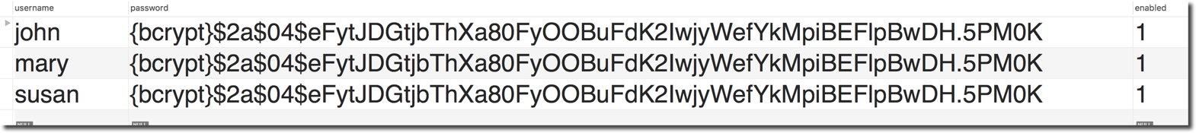

Password Storage - Best Practice
Best Practice
•
The best practice is store passwords in an encrypted format
Encrypted version of password
www.luv2code.com

Slide 4
Spring Security Team Recommendation
•
Spring Security recommends using the popular bcrypt algorithm
•
bcrypt
•
Performs one-way encrypted hashing
•
Adds a random salt to the password for additional protection
•
Includes support to defeat brute force attacks
www.luv2code.com

Slide 5
Bcrypt Additional Information
•
Why you should use bcrypt to hash passwords
www.luv2code.com/why-bcrypt
•
Detailed bcrypt algorithm analysis
www.luv2code.com/bcrypt-wiki-page
•
Password hashing - Best Practices
www.luv2code.com/password-hashing-best-practices
www.luv2code.com

Slide 6
How to Get a Bcrypt password
You have a plaintext password and you want to encrypt using bcrypt
•
Option 1: Use a website utility to perform the encryption
•
Option 2: Write Java code to perform the encryption
www.luv2code.com

Slide 7
How to Get a Bcrypt password - Website
•
Visit: www.luv2code.com/generate-bcrypt-password
•
Enter your plaintext password
•
The website will generate a bcrypt password for you
www.luv2code.com

Slide 8
Development Process
Step-By-Step
Run SQL Script that contains encrypted passwords
A. Modify DDL for password field, length should be 68
Modify database properties file to point to new database schema
THAT’S IT … no need to change Java source code :-)
www.luv2code.com

Slide 9





Spring Security Password Storage
In Spring Security 5, passwords are stored using a specific format
{id}encodedPassword
ID Description
noop | Plain text passwords
bcrypt | BCrypt password hashing
… | …
www.luv2code.com

Slide 10



Spring Security Password Storage
In Spring Security 5, passwords are stored using a specific format
{bcrypt}encodedPassword
Password column must be at least 68 chars wide
{bcrypt} - 8 chars
encodedPassword - 60 chars
www.luv2code.com

Slide 11



Modify DDL for Password Field
CREATE TABLE `users` (
`username` varchar(50) NOT NULL,
Password column must be at least 68 chars wide
`password` char(68) NOT NULL,
{bcrypt} - 8 chars
encodedPassword - 60 chars
`enabled` tinyint(1) NOT NULL,
PRIMARY KEY (`username`)
) ENGINE=InnoDB DEFAULT CHARSET=latin1;
www.luv2code.com

Slide 12








Step 1: Develop SQL Script to setup database tables
The encoding
algorithm id
The encrypted password: fun123
I rs`
V
(‘john','{bcrypt}$2a$04$eFytJDGtjbThXa80FyOOBuFdK2IwjyWefYkMpiBEFlpBwDH.5PM0K',1),
NSERT INTO `use
ALUES
('mary','{bcrypt}$2a$04$eFytJDGtjbThXa80FyOOBuFdK2IwjyWefYkMpiBEFlpBwDH.5PM0K',1),
('susan','{bcrypt}$2a$04$eFytJDGtjbThXa80FyOOBuFdK2IwjyWefYkMpiBEFlpBwDH.5PM0K',1);
Let’s Spring Security know the passwords are stored as encrypted passwords: bcrypt
www.luv2code.com

Slide 13


Step 1: Develop SQL Script to setup database tables
The encoding
algorithm id
The encrypted password: fun123
INSERT INTO `users` VALUES
(‘john','{bcrypt}$2a$04$eFytJDGtjbThXa80FyOOBuFdK2IwjyWefYkMpiBEFlpBwDH.5PM0K',1),
('mary','{bcrypt}$2a$04$eFytJDGtjbThXa80FyOOBuFdK2IwjyWefYkMpiBEFlpBwDH.5PM0K',1), ('susan','{bcrypt}$2a$04$eFytJDGtjbThXa80FyOOBuFdK2IwjyWefYkMpiBEFlpBwDH.5PM0K',1);
www.luv2code.com

Slide 14


Step 2: Point to New Database Schema
File: src/main/resources/persistence-mysql.properties
#
# JDBC connection properties #
jdbc.driver=com.mysql.jdbc.Driver
jdbc.url=jdbc:mysql://localhost:3306/spring_security_demo_bcrypt?useSSL=false jdbc.user=springstudent
jdbc.password=springstudent
#
# Connection pool properties #
connection.pool.initialPoolSize=5 connection.pool.minPoolSize=5 connection.pool.maxPoolSize=20 connection.pool.maxIdleTime=3000
www.luv2code.com

Slide 15
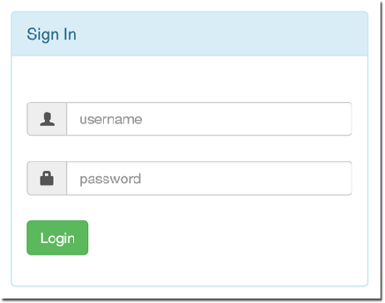




Spring Security Login Process
User enters plaintext password
Spring Security Filters
www.luv2code.com

Slide 16




Spring Security Login Process
User enters
plaintext password
Spring Security Filters
Retrieve password from db for the user
Read the encoding algorithm id (bcrypt etc)
For case of bcrypt, encrypt plaintext password from login form (using salt from db password)
Compare encrypted password from login form WITH encrypted password from db
If there is a match, login successful
If no match, login NOT successful
www.luv2code.com

Slide 17


Spring Security Login Process
User enters
plaintext password
Spring Security Filters
Note:
The password from db is NEVER decrypted
Because bcrypt is a one-way
encryption algorithm
1. Retrieve password from db for the user
2. Read the encoding algorithm id (bcrypt etc)
For case of bcrypt, encrypt plaintext password from login form (using salt from db password)
Compare encrypted password from login form WITH encrypted password from db
If there is a match, login successful
If no match, login NOT successful
www.luv2code.com

